Slide 1
Contactless thermometer
Done By:
Thanuj Kumar S - 20171CSE0726
Utsav Deep - 20171CSE0734
Tejas Bhatnagar - 20171CSE0721
Thajudheen TK - 20171CS0724
Udith L Narayan - 20171CSE0732

Slide 2
Introduction
Continuous body temperature monitoring is the one of the way to detect a corona patient. So many types of thermometers are available in market. The normal thermometer can measure the temperature of a covid patient and also may spread the virus
In this special situation we can use the Non Contact Thermometer. And also known this device as temperature gun.
The main component of this Non Contact Thermometer is a Non contact temperature sensor.

Slide 3
Components Used
Non Contact Temperature Sensor
Arduino board
Jumper Wires
OTG Adapter
Android phone
Serial Monitor Android App

Slide 4
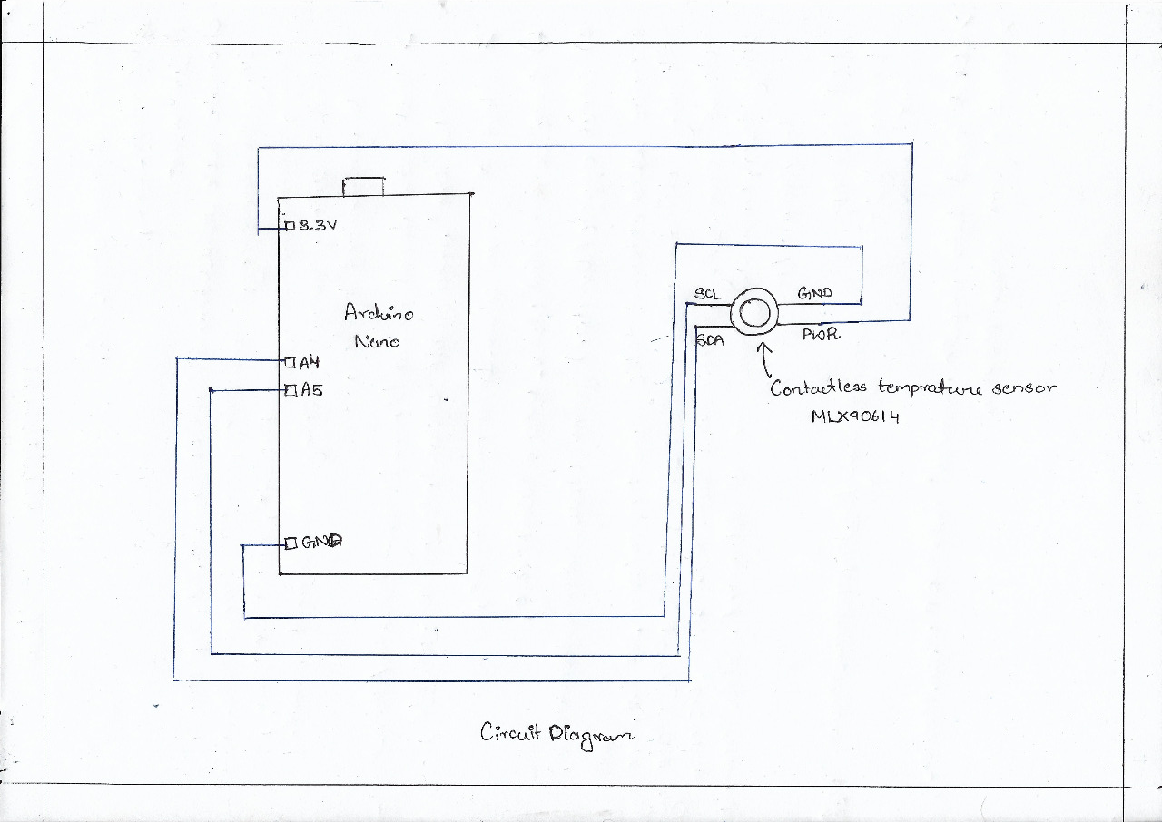
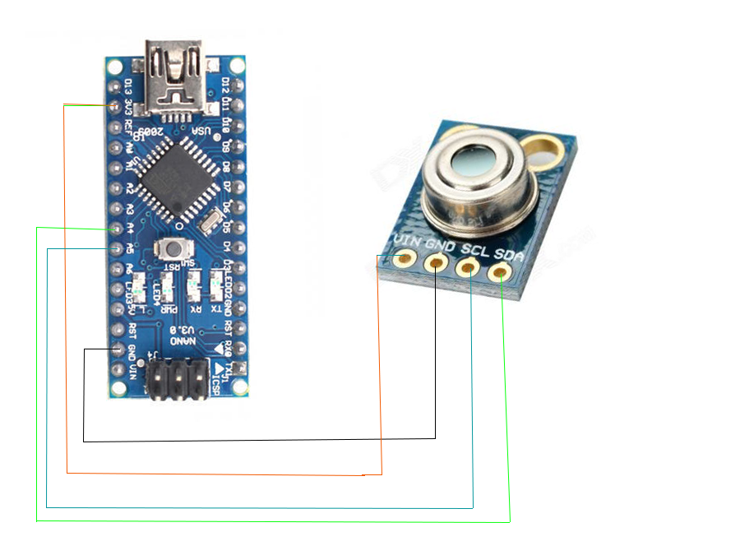
Circuit Diagram

Slide 5
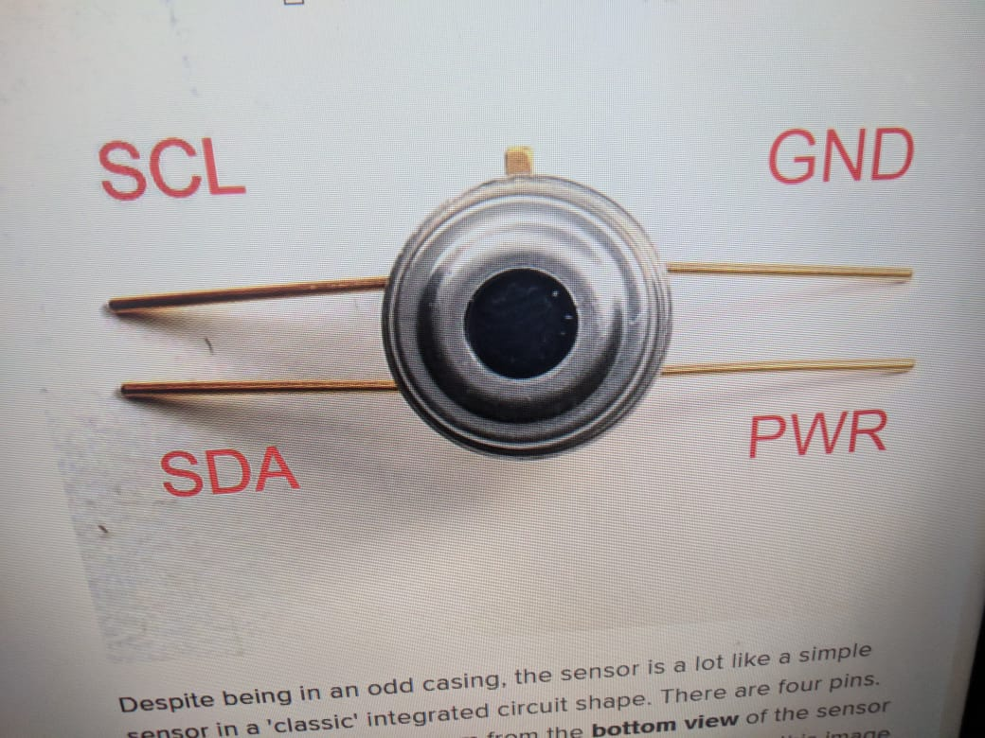
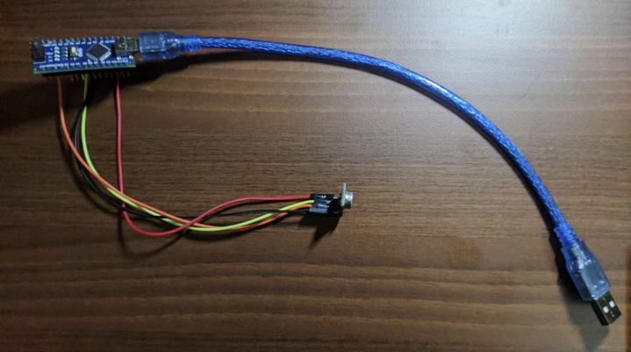
Pictures of Components
Contactless temperature sensor
Arduino with OTG Adapter connected to sensor with jumper cables

Slide 6
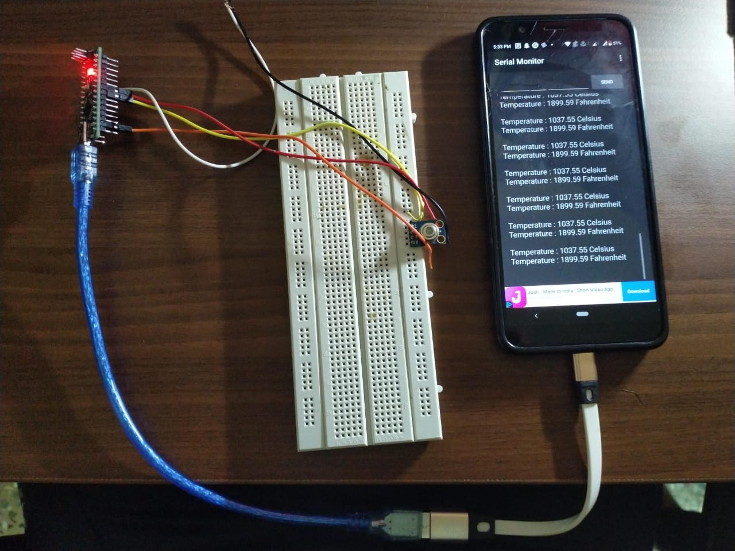
Picture of our complete project

Slide 7
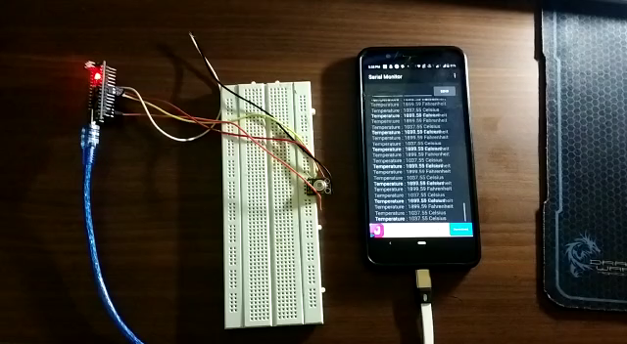
Working video of our project

Slide 8
Cost of each components
Arduino nano Price – 340
Contactless Temperature Sensor Price – 1094
Female to female jumper Price -180
OTG cable Price -169
Total -1783

Slide 9
Conclusion
In these times of a pandemic maintaining a safe distance from suspected person is very crucial and taking their temperature is one of the repetitive task that needs to be done. So with the help of this Contactless thermometer that task can be made safer.
Since the components used in the project are easily available it's easy to make for anyone and easy to use as well.

Slide 10
Thank You

